Slide 1
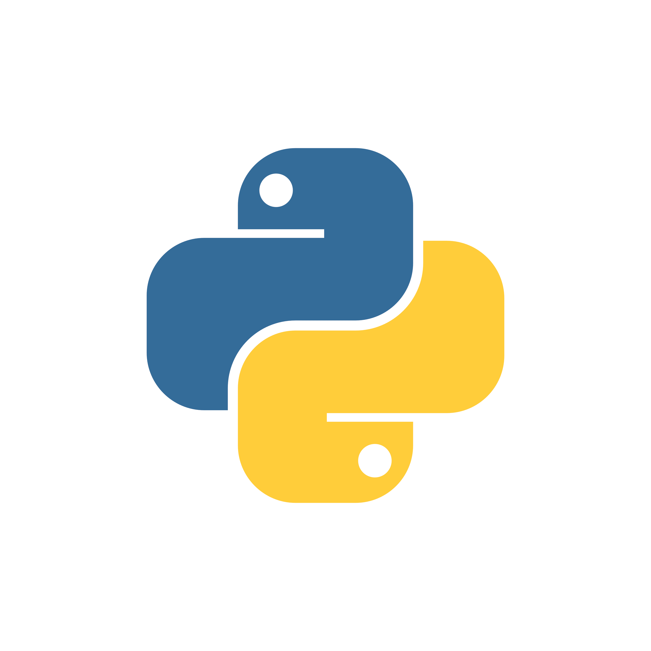
Bloggrammer.com
How to Create Virtual Env in Python

Slide 2
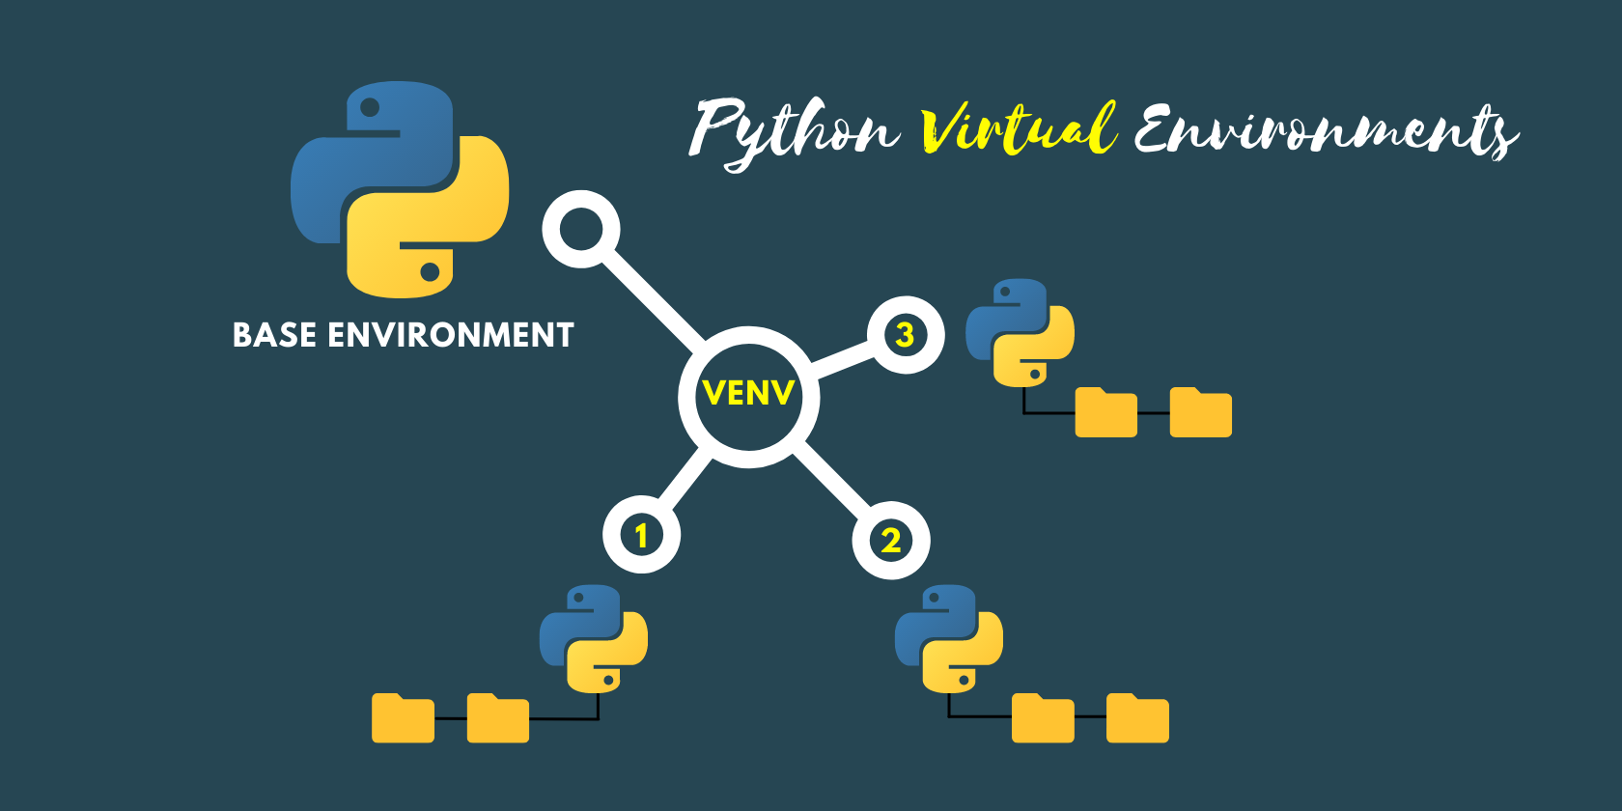

Slide 3




Why Use Virtual Environments?
Dependency Management
Dependency Isolation
Reproducibility

